Slide 1


APS1052 Final Project APPLE Stock Prediction
Students:
Jiawei Ma
Long Ye
Notes:
Hello everyone, here is our APS1052 final project: APPLE Stock Prediction. Here are our group members: Jiawei Ma, Long Ye. Now, let’s start our presentation.

Slide 2
1. Introduction
-Apple (Stock)
-Machine Learning (ML) Prediction
Notes:
Firstly, let’s briefly introduce the background and the purpose in this project. We will introduce the Apple Inc. and the value of its stock. Then we will introduce the Machine Learning method that we can apply to predict the stocks.

Slide 3
Apple
One of the largest and most valuable companies in the world
Known for designing, developing, and selling consumer electronics, computer software, and online services
Worth investing in
Notes:
Apple is a multinational technology company based in Cupertino, California. It was founded in 1976 by Steve Jobs, Steve Wozniak, and Ronald Wayne, and has since grown to become one of the largest and most valuable companies in the world. Apple is known for designing, developing, and selling consumer electronics, computer software, and online services. Its most popular products include the iPhone, iPad, Mac, Apple Watch, and AirPods. Apple is also a leader in the digital music, streaming, and entertainment industry, with services such as Apple Music, Apple TV+, and the App Store. In conclusion, Apple Inc. stocks are worthy to invest. Therefore, the purpose of this research is to investigate the performance of different machine learning models in predicting the stock prices of Apple.

Slide 4
Machine Learning
Used machine learning to predict Apple stock prices
Models used:
Linear Regression
Random Forest
Decision Tree
K-Nearest Neighbors
Used Amazon, Google, META, and Netflix stock data to assist in predicting the trend of Apple stock
Study may inform investment strategies
Notes:
Predicting stock market trends is a challenging task that has attracted the attention of researchers and practitioners from various fields, including finance, economics, and computer science. One popular approach to forecasting stock prices is to apply machine learning techniques, which leverage other relevant features to learn patterns and make predictions.
In this study, we focus on predicting the stock prices of Apple because Apple is one of the world's largest and most influential companies.
Specifically, we explore the performance of several machine learning models, including Linear Regression with and without Principal Component Analysis (PCA), Random Forest, Decision Tree, and K-Nearest Neighbors (KNN). In the Linear Regression with PCA, we also investigate the impact of using additional features from other tech companies in "Big Techs": Amazon, Google, META, and Netflix, to assist in predicting the trend of Apple stock.
The findings of this study may provide insights into the effectiveness and limitations of different machine-learning approaches for predicting stock prices and informing investment strategies.

Slide 5
2. Data Collection
Stock Data Collect From 2022-02-24 to 2023-02-23
☆Apple☆: https://finance.yahoo.com/quote/AAPL/history?p=AAPL
Amazon : https://finance.yahoo.com/quote/AMZN/history?p=AMZN
Google : https://finance.yahoo.com/quote/GOOG/history?p=GOOG
META : https://finance.yahoo.com/quote/META/history?p=META
Netflix : https://finance.yahoo.com/quote/NFLX/history?p=NFLX
Accessible from Yahoo Finance
Notes:
We are going to predict the Apple stock price. We also used the data from Amazon, Google, META, and Netflix to improve the prediction trends. The data csv files can be accessed and downloaded from yahoo finance.

Slide 6
Features in Dataset
Date : The recorded date of the stock
Open : The opening price when the stock day started
High : Highest price reach of the stock during the day
Low : Lowest price reach of the stock during the day
Close : The closing price when the stock day end
Adj Close : The adjusted closing price amends a stock's closing price to reflect that stock's value after accounting for any corporate actions.
Volume : The number of shares traded in a particular stock, index, or other investment over a specific period of time.
Notes:
In each dataset from the companies, it has several features: Date, Open, High, Low, Close, Adj Close, Adj Close, and Volume.
The ‘Date’ is the recorded date, ‘Open’ is the opening price when the stock day started. ‘High’is highest price reach of the stock during the day. And ‘Low’ is the opposite one to show the lowest price in that day. ‘Close’is the closing price when the stock day end. ‘Adj Close’is the adjusted closing price amends a stock’s closing price to reflect that stock's value after accounting for any corporate actions. Lastly,‘Volume’represents the number of shares traded in a particular stock, index, or other investment over a specific period of time.
In. this study, we are interested in predict the ‘Open’ price of each day, so that in the beginning of the day, we can determine whether we should invest or sell the stocks.. We will use all other features to predict Open price.

Slide 7
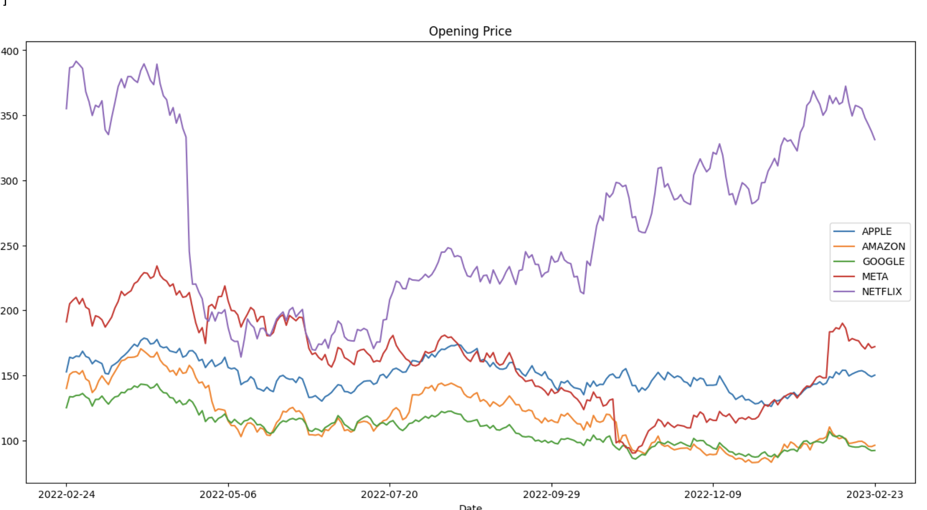
Stock Open Price Visualization
Notes:
Here is the stock Open price data visualization from those five companies’ dataset. The date range is from 2022-02-24 to 2023-02-23. We can see the trends for the ‘Big Tech’stocks Open price are similar. And the other companies' data would be helpful to predict Apple stock Open price.

Slide 8
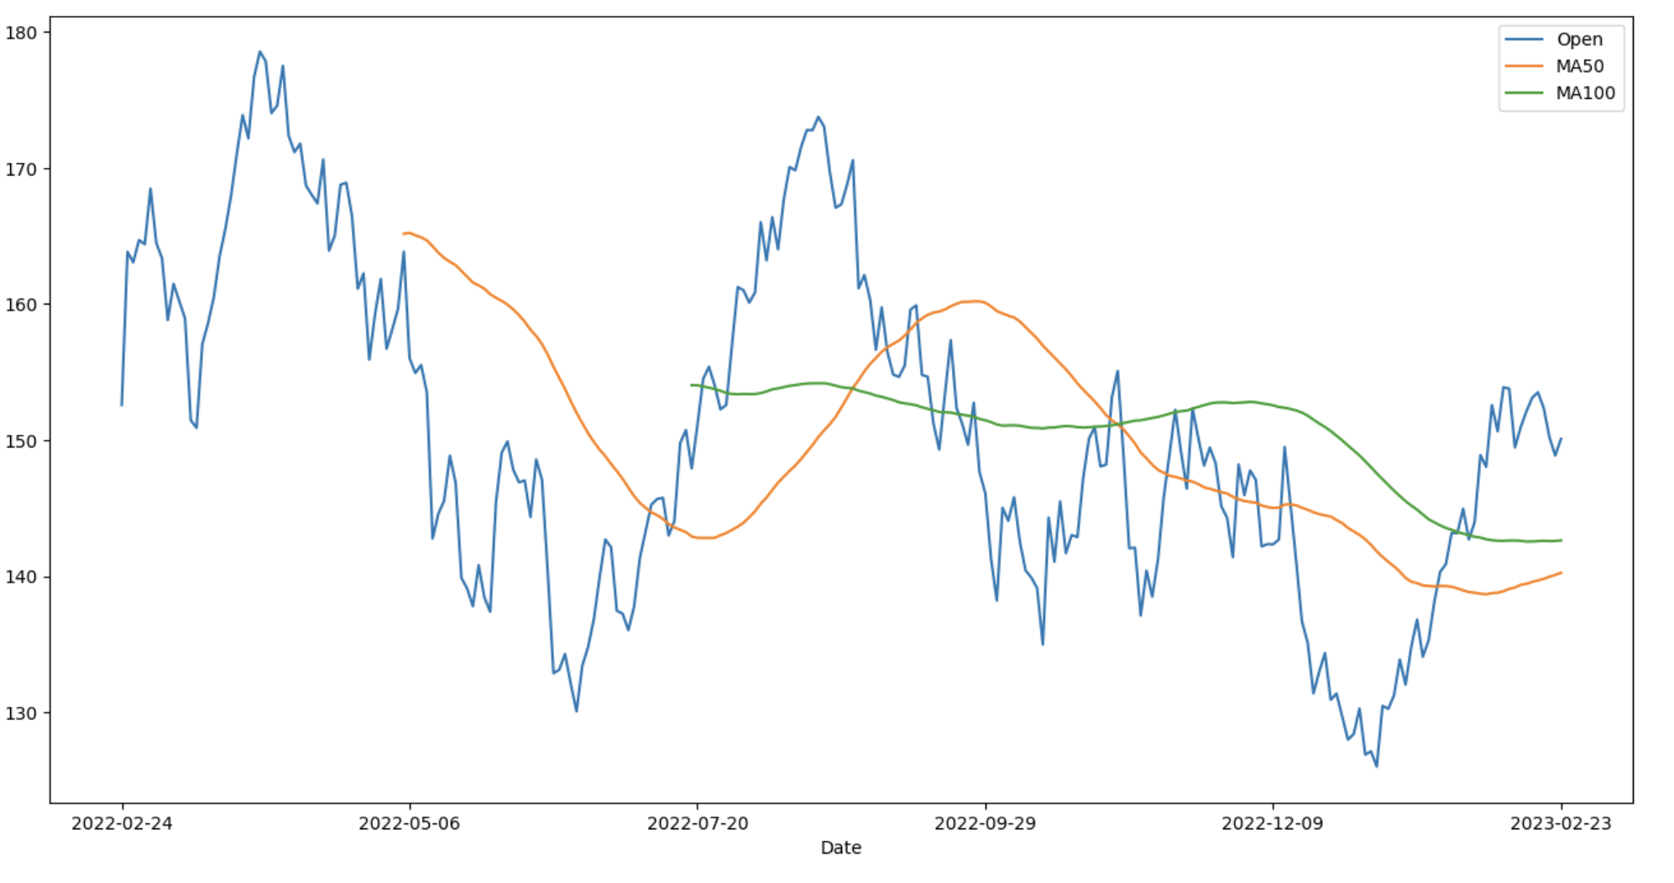
Apple Stock Open Price Trends in 50 days and 100 days.
Notes:
Here is the trends for Apple Stock Open Price in 50 days and 100 days. MA50 shows the mean of Open price in 50 days. And the MA100 shows the mean of Open price in 100 days. We can see that the stock is relatively stable. It also proved the Apple Stock is worthy to invest.

Slide 9

Train and Test data split
The date is from 2022-02-24 to 2023-02-23.
All data except the last month's data as the training data
The last month's data (in Feb,2023) as the test data.
Notes:
The date is from 2022-02-24 to 2023-02-23. We used all data except the last month's data (2022-02-24 to 2023-01-31) as the training data and the last month's data (in Feb,2023) as the test data.

Slide 10

3. Machine Learning Models
Notes:
Now, let’s give a brief introduction to the models that we will apply.

Slide 11
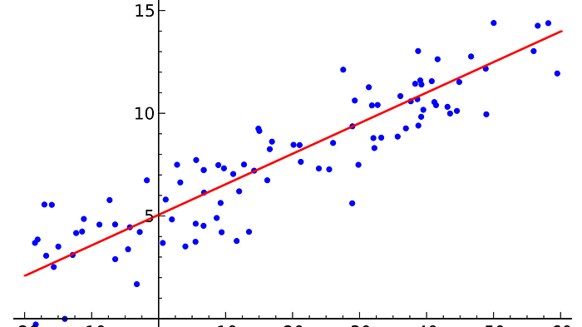
3.1 Linear Regression
Notes:
The first model we applied is Linear Regression model.

Slide 12
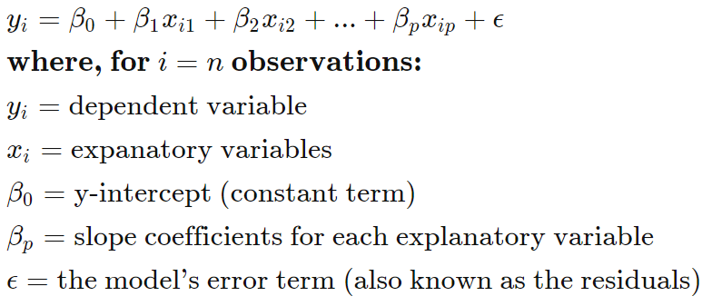
Notes:
The linear regression model is a supervised machine learning model. It will find the best fit linear lines between the independent and dependent variables. Here is the formula for the multiple linear regression. In this formula, the beta-0 is the constant; those Xis are the explanatory variables (predictor attributes or features); the beta-p are the slop coefficients (or weights) for the corresponding variable; the yi is the dependent variable which is our target (APPLE’s ‘Open’ value in dataset). And the epsilon is the error of the formula, which we cannot get rid of.

Slide 13
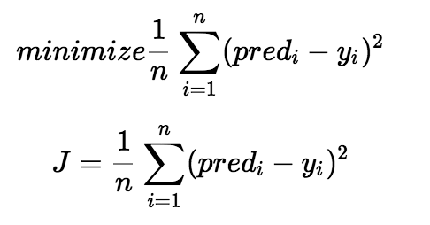
Cost Function
Notes:
Here is the cost function for the linear regression. Our goal is to minimize the error differences as shown in the first formula. We square the error difference and sum over all data points and divide that value by the total number of data points. This provides the average squared error over all the data points. Therefore, this cost function is also known as the Mean Squared Error(MSE) function. Then we can change the values of the weights (betas) including the constant to minimize the cost function.
Moreover, this cost function can also be used in other machine learning models to have a better prediction.

Slide 14

3.2 Principle Component Analysis (PCA)
Notes:
Now, we will briefly introduce the PCA that we applied in the linear regression to improve the prediction performance. PCA (Principal Component Analysis) is a commonly used technique for reducing the dimensionality of data in data analysis and machine learning. It involves transforming high-dimensional data into a lower-dimensional space while retaining as much of the original information as possible. PCA finds a new set of variables called principal components that are linear combinations of the original features of the data. By selecting a subset of principal components that capture the majority of the variance, PCA can effectively reduce the dimensionality of the data, making it easier to visualize and analyze.
From this GIF graph, we can see that as the line rotates, the projection of each data points (also the features captured by the line) are different. And then, the two dimension datapoints would be transformed into 1-d datapoints. Our goal is to find the principal components that are linear combinations of the features to reduce the dimensionality of our dataset.

Slide 15

3.3 Random Forest Regression
Notes:
Next, we will introduce the random forest regression model. Random forest is an ensemble learning method that constructs a multitude of decision trees at training time and combines them into a forest. Random Forest improves upon decision trees by using bootstrap aggregating and random feature selection to reduce overfitting and increase accuracy. During prediction, the Random Forest model outputs the mode (for classification) or mean (for regression) of the predictions of the individual trees in the forest.
In our model, we give all features to the random forest as input. Through its random feature selection, we can get the prediction values that reduce overfitting and increase accuracy.

Slide 16
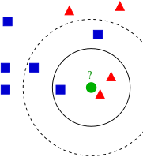
3.4 K-Nearest Neighbors (KNN)
Notes:
Next model is K-Nearest Neighbors (KNN). KNN is a popular machine learning algorithm used for classification and regression tasks. It is a non-parametric method that works by finding the K training samples closest in distance to a new input data point and outputting the average of their target values for regression or the mode of their target values for classification. KNN is simple to implement and can work with any number of classes or regression targets. However, it can be sensitive to the choice of the distance metric and the value of K, and can become computationally expensive for large datasets.
In our model, we will train the KNN model as samples. And for each test data, the KNN model will predict it based on the K training samples closest in distance.

Slide 17

3.5 Decision Tree
Notes:
Last model is Decision Tree. Decision tree is a popular machine learning algorithm used for classification and regression tasks. It creates a model in the form of a tree structure, where each internal node represents a test on an attribute, each branch represents the outcome of the test, and each leaf node represents a class label or a numerical value. The decision tree is constructed by recursively splitting the data based on the attribute that provides the most information gain, which measures the reduction in entropy or impurity after the split. Decision trees are easy to interpret and visualize, and can handle both categorical and continuous data. However, they can suffer from overfitting and can be unstable with small variations in the data.

Slide 18

4. ML Results
Notes:
Next, let’s discuss the results we got from the models.

Slide 19

4.1 Linear Regression
Linear Regression with PCA
Linear Regression without PCA
Notes:
We applied two versions of the Linear Regression model, one is the LR without PCA, and another one is LR with PCA.

Slide 20
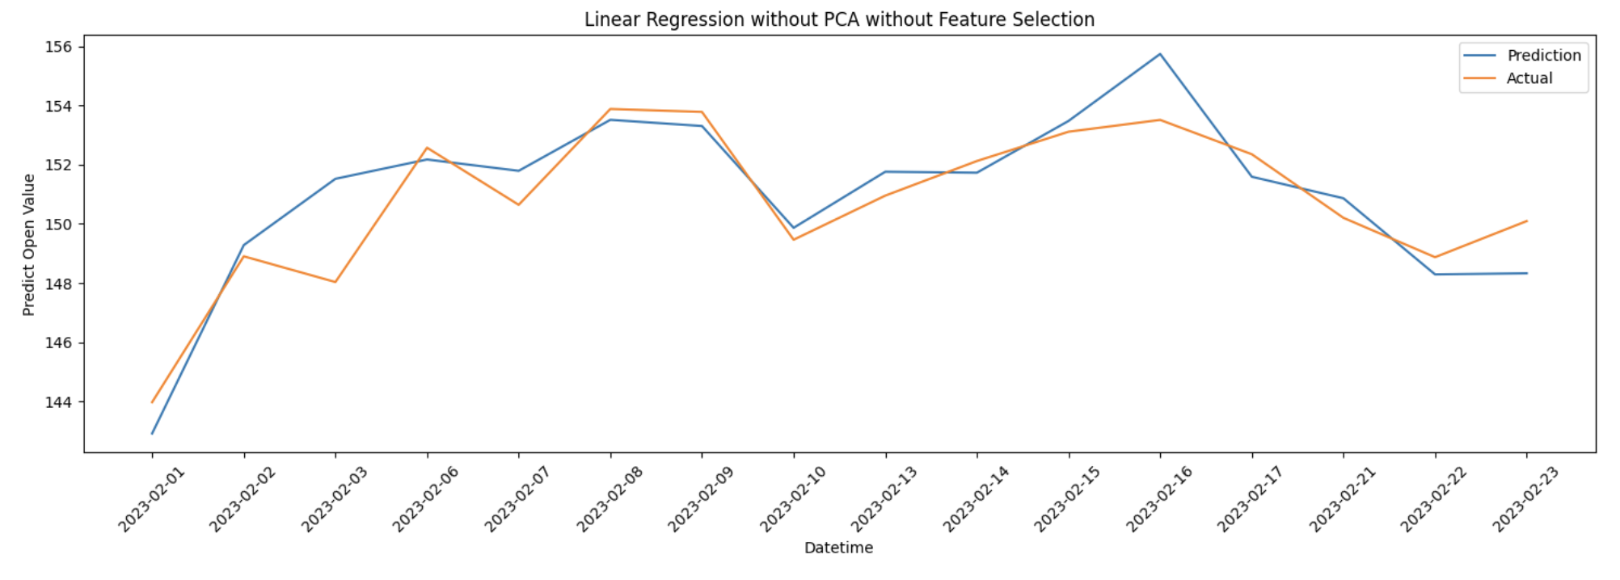
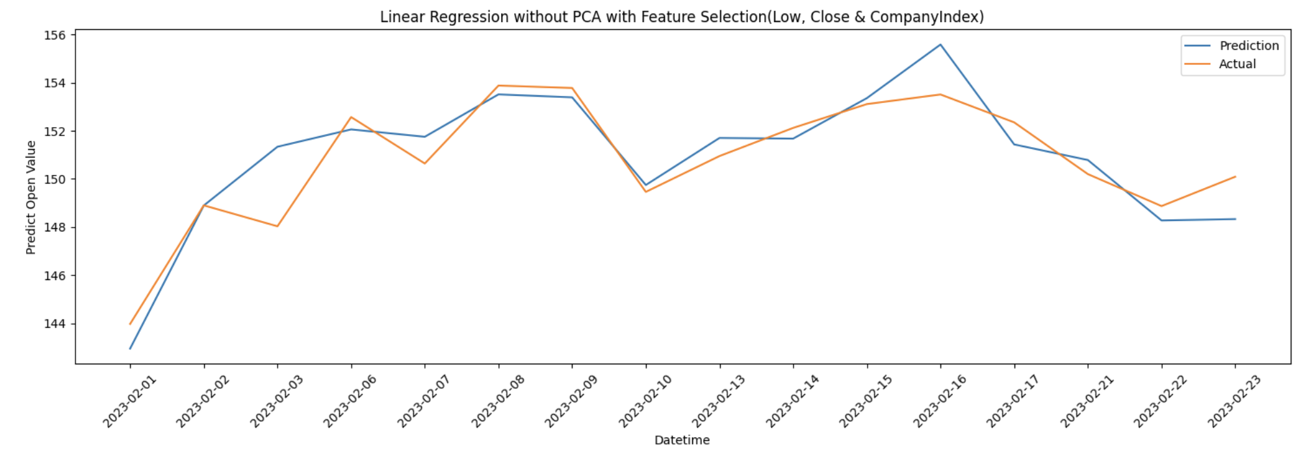
4.1.1 LR without PCA
Accuracy = 99.36%.
Accuracy =99.40%.
Notes:
By using Linear Regression model without PCA, we tried prediction through selecting all features and selecting partial important features.
The top graph is the model with all features; the accuracy is 99.36%.
And bottom graph is the model that we select Low, Close and CompetitorIndex (typo in the screenshot) features; the accuracy is 99.4%.

Slide 21
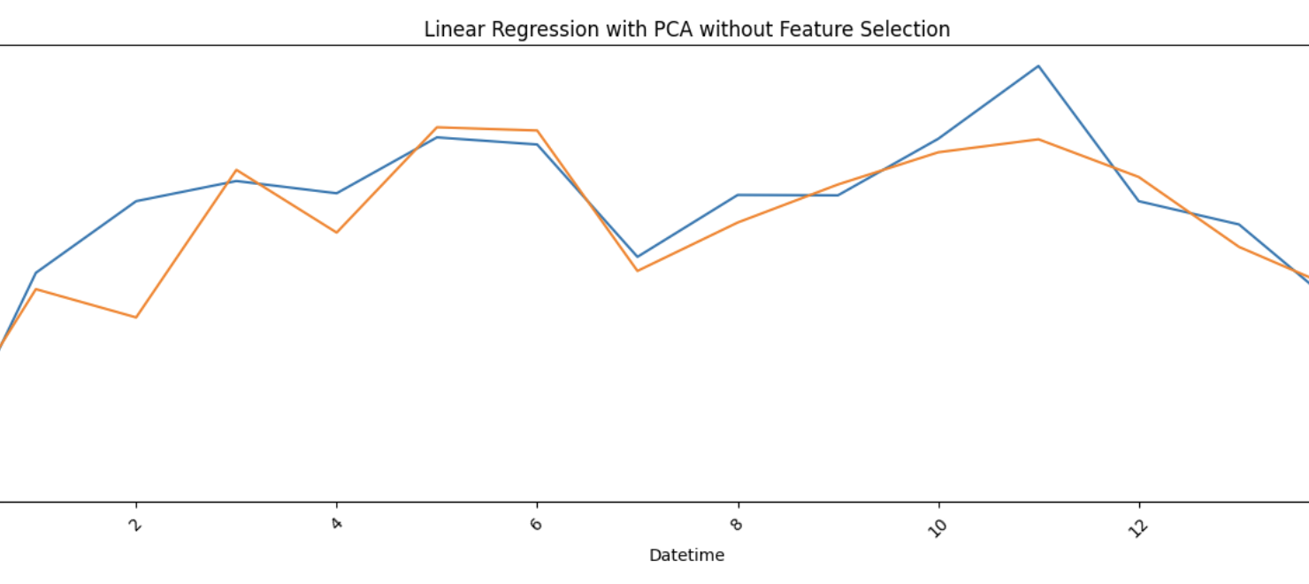
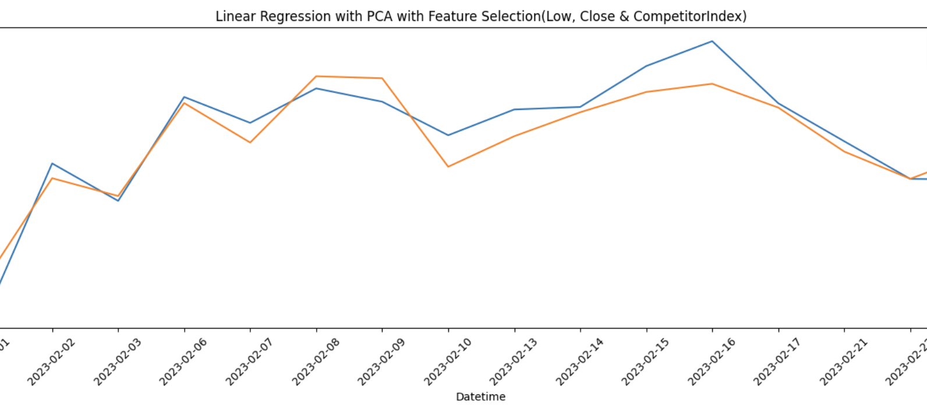
4.1.2 LR with PCA
Accuracy = 99.36%.
Accuracy =99.41%.
Notes:
By using Linear Regression model with PCA, we also tried prediction through selecting all features and selecting partial important features.
The top graph is the model with all features; the accuracy is still 99.36%.
And bottom graph is the model that we select Low, Close and CompetitorIndex features; the accuracy is 99.41%..
Although results are similar, the LR model with PCA and with Feature selection still slightly improved the accuracy.

Slide 22
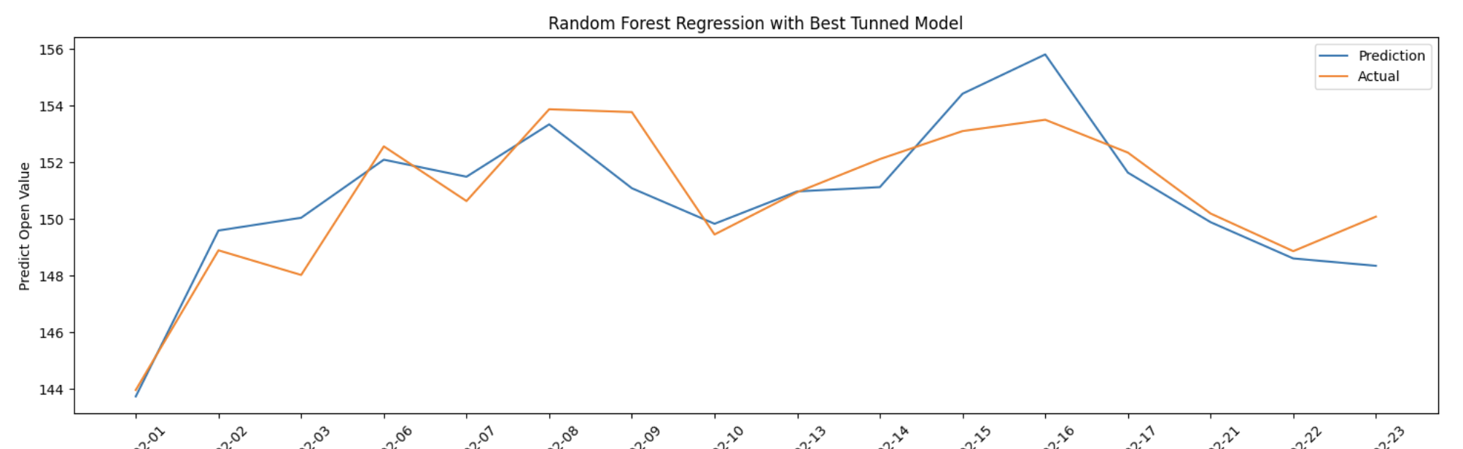
4.2 Random Forest
Accuracy = 99.36%.
Notes:
By tuning the parameters, we found the best model parameters for random forest at {‘n_estimators’: 600, ‘min_samples_split’: 2, ‘min_samples_leaf’: 2, ‘max_features’: ‘sqrt’, ‘max_depth’: 110, ‘bootstrap’: False}. And the accuracy is 99.36%.

Slide 23
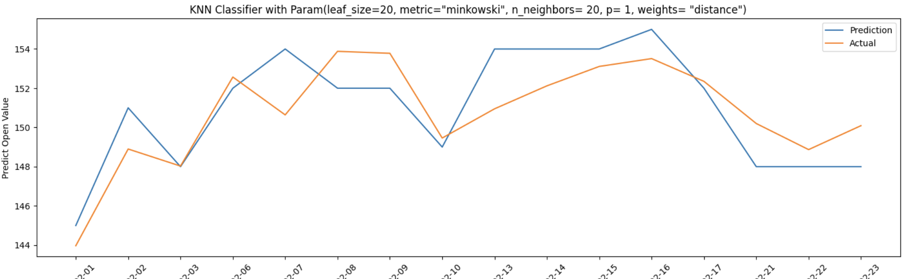
4.3 KNN
Accuracy = 99.01%
Notes:
By tuning the parameters, we found the best model parameters for KNN Classifier are {'leaf_size': 20, 'metric': 'minkowski', 'n_neighbors': 20, 'p': 1, 'weights': 'distance’}. The accuracy is 99.01%.

Slide 24
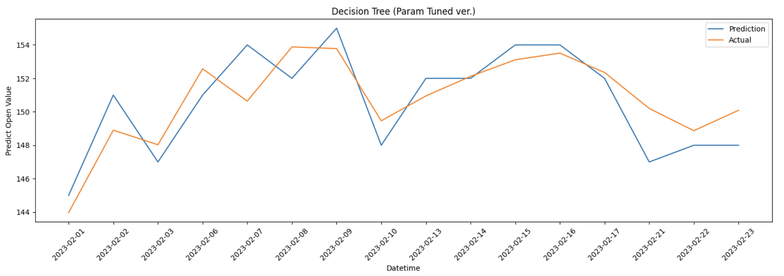
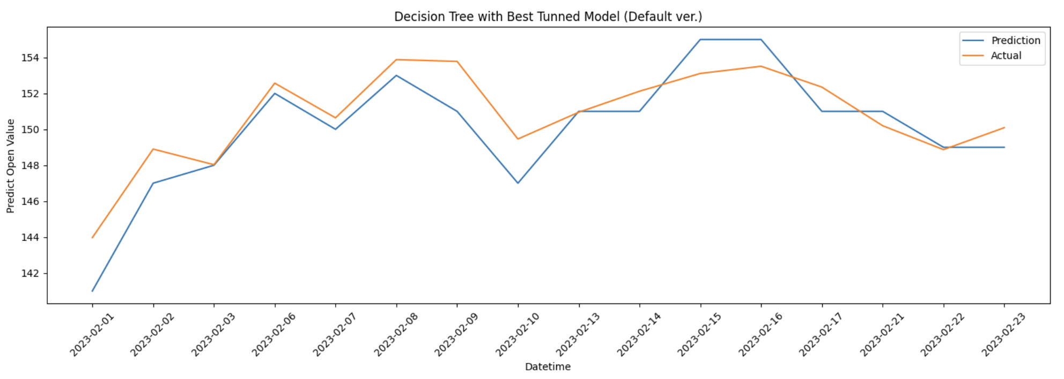
4.4 Decision Tree
Accuracy = 99.06%.
Accuracy =99.16%.
Notes:
In decision tree model, the situation is a little bit different and interesting. Although we found the best model through tuning the parameters and get the best decision tree model with {'dec_tree__criterion': 'gini', 'dec_tree__max_features': 'log2', 'dec_tree__min_samples_leaf': 5, 'dec_tree__min_samples_split': 4, 'pca__n_components': 4} (The Top one). The accuracy is lower than its default model (lower one) with accuracy at 99.16%.

Slide 25

5. Discussion
Notes:
Now, let’s move to the discussion and discuss about the results we got from the models.

Slide 26
Compare accuracy results
Model | Highest Accuracy
LR without PCA | 99.4%
LR with PCA | 99.41%
Random Forest | 99.36%
KNN | 99.01%
Decision Tree | 99.16%
Notes:
From the table, we can see the LR with PCA has the best prediction performance with the highest accuracy at 99.41%. And KNN is the most un-reliable model to predict APPLE stock prices.

Slide 27
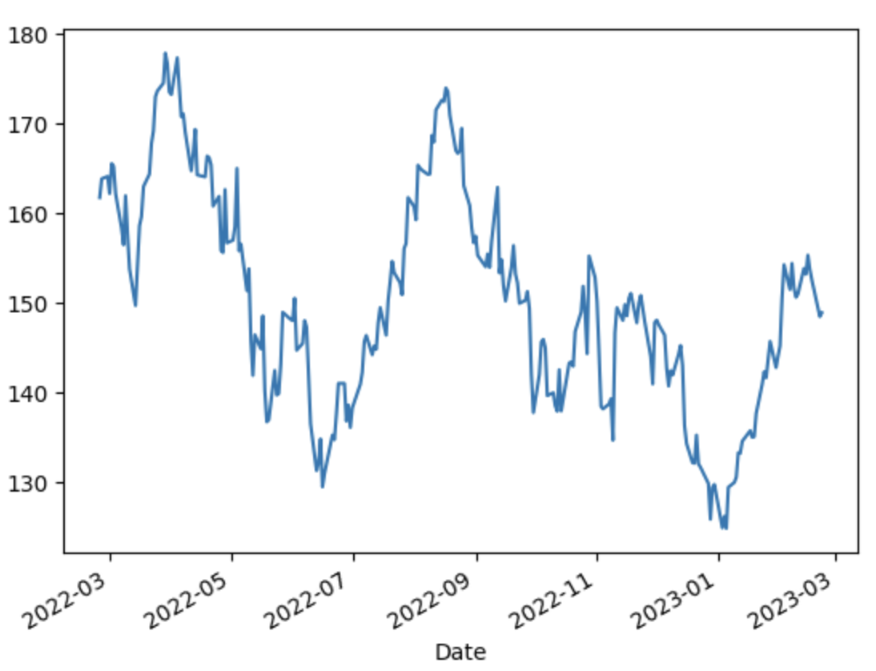
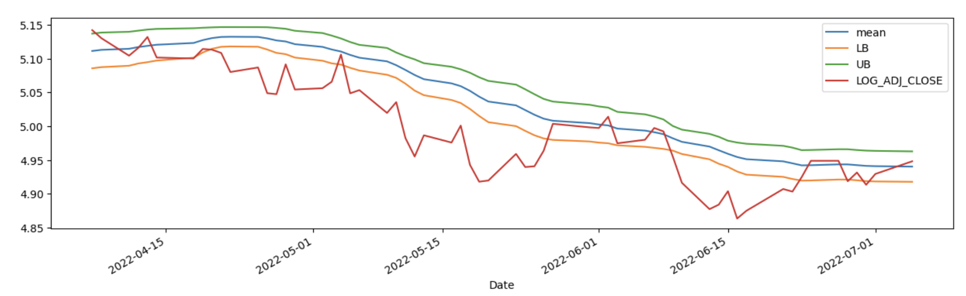
White Reality Check
Notes:
There are some results plots generated from the white reality check. Let’s talk about them one by one. For the left plot, it shows the line for the stock market pricing of APPLE. And the right one shows the mean lower boundary and upper boundary abd the Adj close feature.

Slide 28
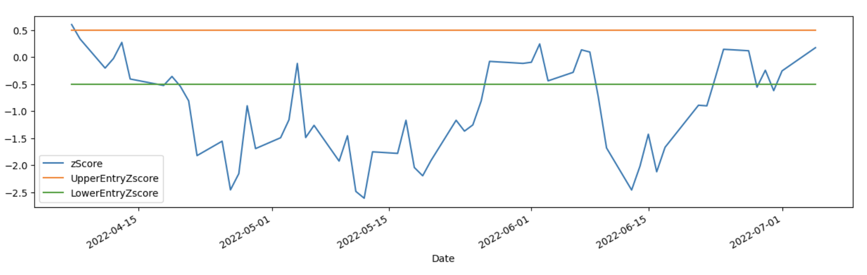
Z-score
Notes:
This plot shows the Z-score calculation with different data, and the upper and lower entry.
The z-score is a statistical measure that represents the number of standard deviations a data point is from the mean of a dataset. In the context of stock data, the z-score is used to determine how far a particular stock's price is from its average price over a given period of time. A positive z-score indicates that the stock's price is above its average, while a negative z-score indicates that the stock's price is below its average.
The UpperEntryZscore and LowerEntryZscore are commonly used in trading strategies based on mean reversion. These z-scores represent the threshold values beyond which a stock's price is considered overbought or oversold, respectively. Traders may use these values as entry signals for trades, where they buy the stock when the price is below the LowerEntryZscore and sell when the price is above the UpperEntryZscore.

Slide 29
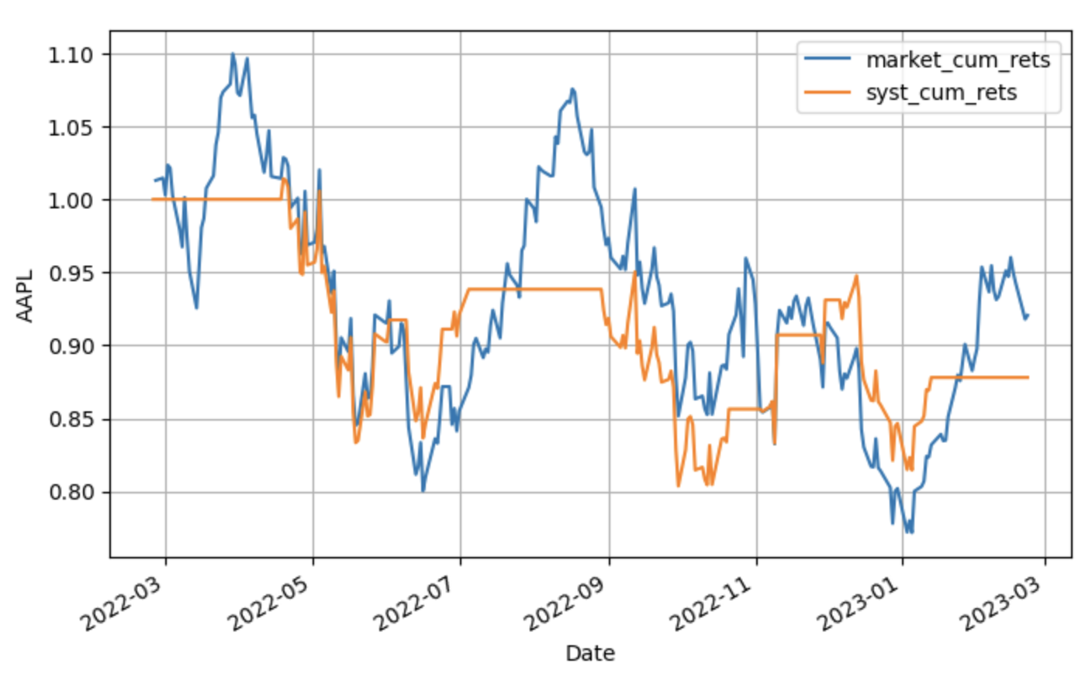
Notes:
This plot is a visualization of the cumulative returns of a stock trading system.
The market_cum_rets line represents the cumulative returns of a benchmark market index, such as the S&P 500 or the NASDAQ Composite. This line shows the performance of the broader market over the same period of time as the trading system.
The syst_cum_returns line represents the cumulative returns of the trading system. This line shows the performance of the trading system over the same period of time as the benchmark market index.
By comparing the two lines, you can evaluate the performance of the trading system relative to the broader market. If the syst_cum_returns line is consistently higher than the market_cum_rets line, the trading system is said to have outperformed the market. If the syst_cum_returns line is consistently lower than the market_cum_rets line, the trading system is said to have underperformed the market.

Slide 30
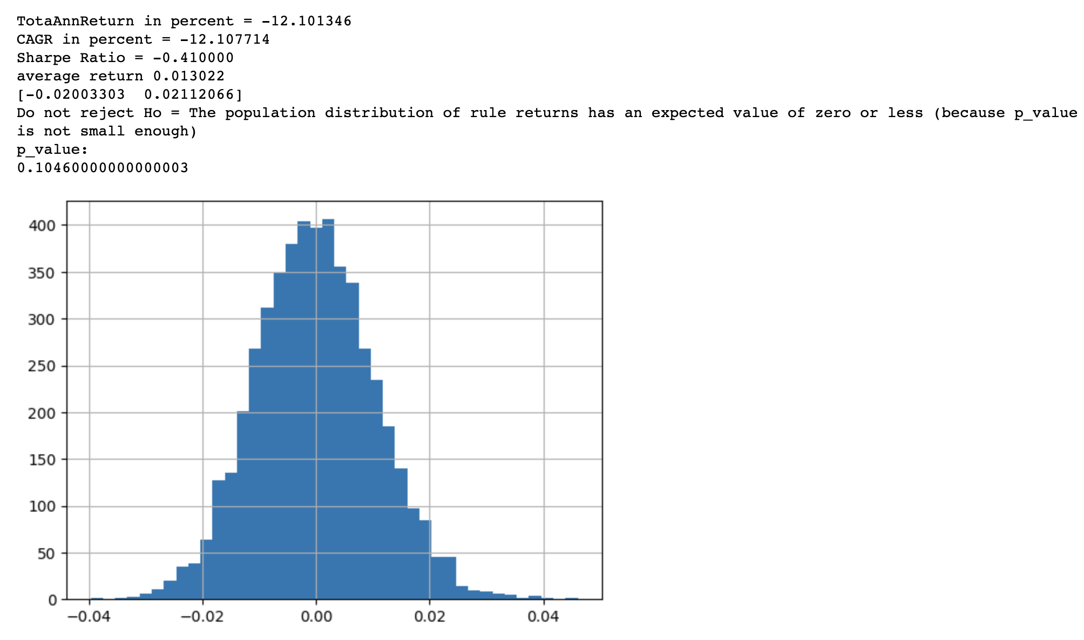
Result Summary
Notes:
Here is the result of the white reality check. The results of the White Reality Check of Apple shows that the trading system being evaluated has produced negative returns, with a total annual return of -12.10% and a compounded annual growth rate (CAGR) of -12.11%. Additionally, the Sharpe Ratio is negative, indicating that the trading system has not generated a sufficient return relative to the level of risk taken.
The average return of 0.013022 indicates that, on average, the trading system has produced a small positive return, but the negative returns have outweighed the positive returns.
The next line of output, [-0.02003303 0.02112066], provides the confidence interval for the average return, which indicates that with 95% confidence, the true average return of the trading system is expected to fall between -0.02003303 and 0.02112066.
The p-value of 0.10460000000000003 indicates that the null hypothesis that the population distribution of the rule returns has an expected value of zero or less cannot be rejected at the 5% significance level. This means that the evidence is not strong enough to conclude that the trading system's returns are significantly different from zero or less.
Overall, the results suggest that the trading system has not performed well.

Slide 31
Conclusion
Linear Regression with PCA is the best model to predict APPLE stock values.
APPLE stock currently does not perform well, be caution to buy the stocks.
Possible reasons: Pandemic & Bad Economy
Notes:
In conclusion, in this study, the linear regression model with PCA performs best to predict APPLE stock values. However, currently, APPLE stock does not perform well in the past year, this might be caused by pandemic, economy reasons (bad economy, inflation) from pandemic recovery.

Slide 32

Thank You
Sabatino Costanzo-Alvarez
&
Rosario Lorenza Trigo-Ferre
Notes:
Thanks to Professors Sabatino Costanzo-Alvarez and Rosario Lorenza Trigo-Ferre for their teaching and guidance this semester.
Thank you for watching and listening.

